Slide 1
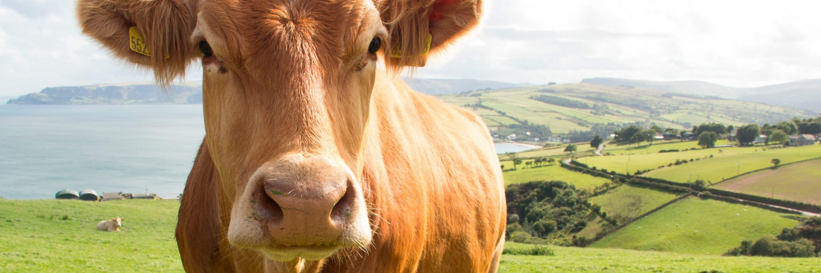

COMPRESSION AND DECOMPRESSION OF IMAGES FOR PRECISION FARMING

Slide 2

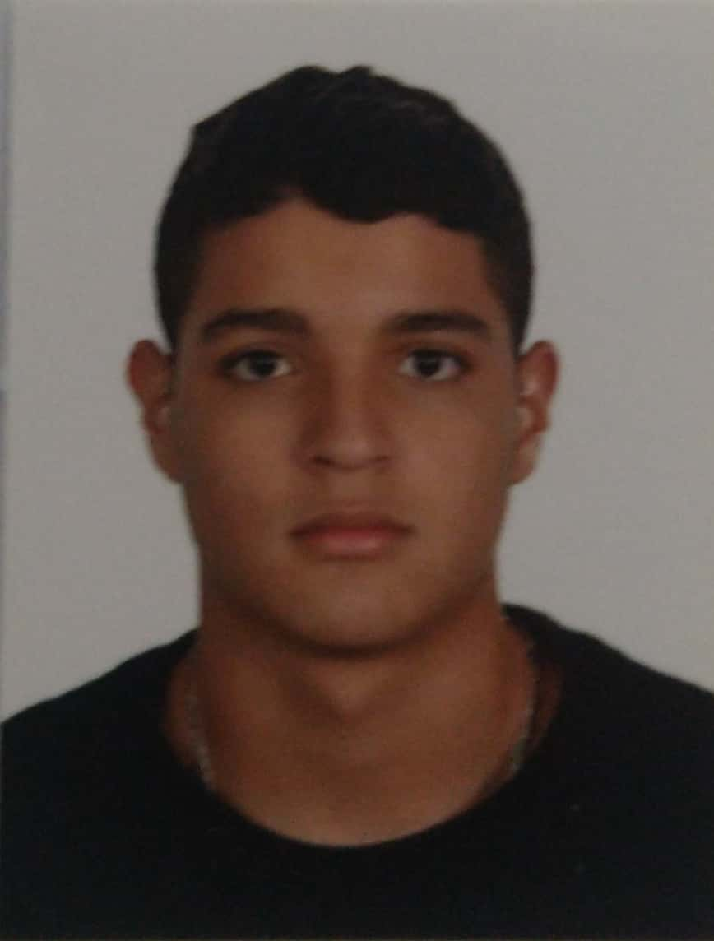

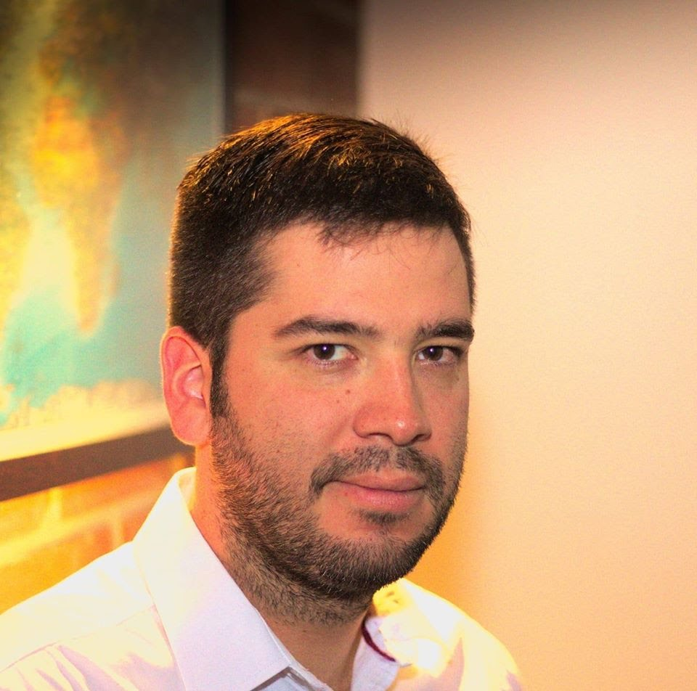


Team Presentation
Alejandro Torres Muñoz
Mateo Muñoz Cadavid
Simón Marín
Mauricio
Toro
https://github.com/mmc31-08/ProyectoDatos_y_Algoritmos

Slide 3
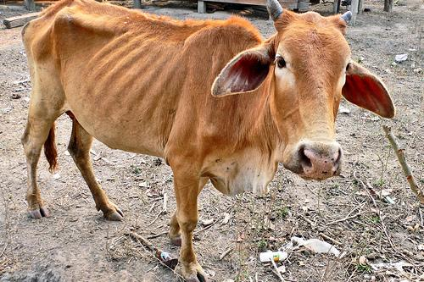
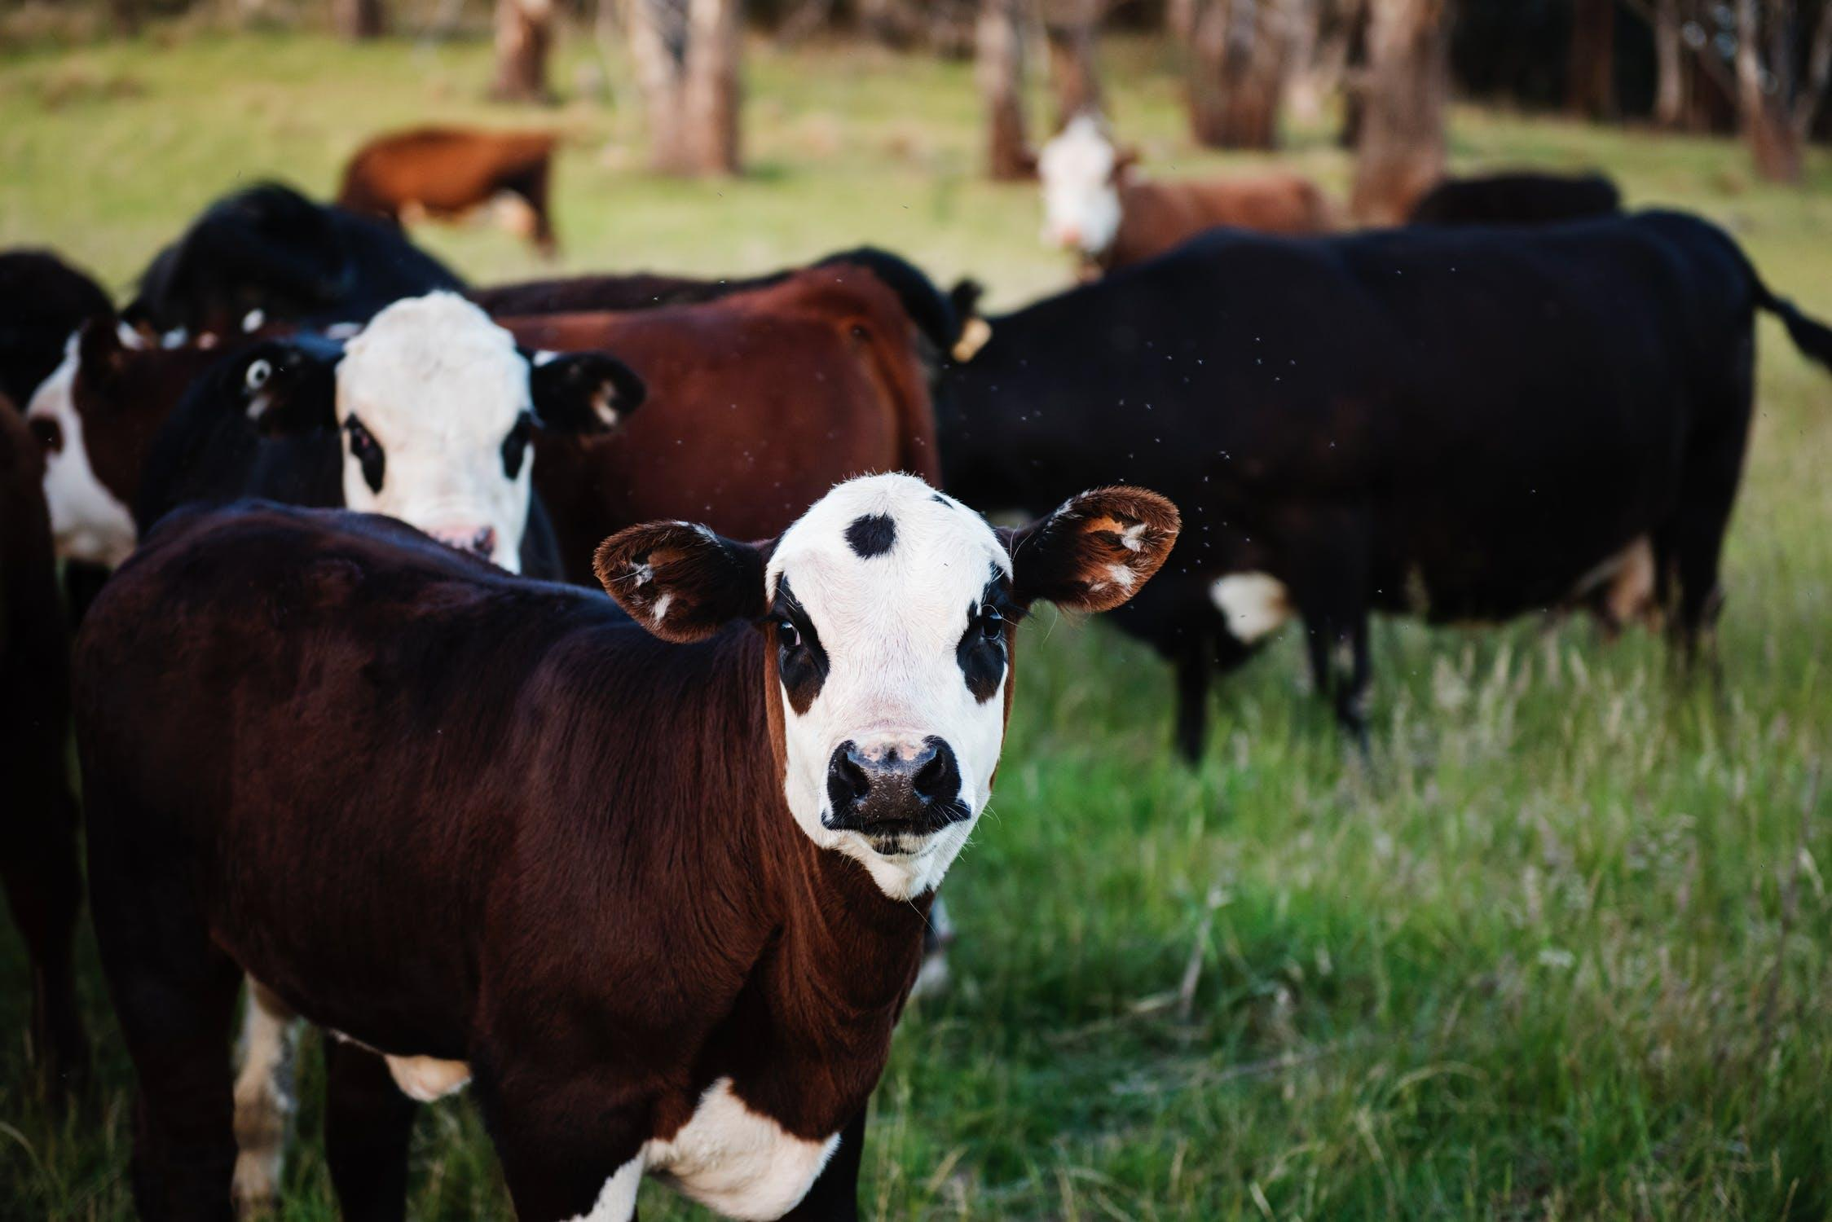
Training Process
Convolutional Neural Network
Sick-Cattle Images
Classification Algorithm
Classification Model
Healthy-Cattle Images

Slide 4
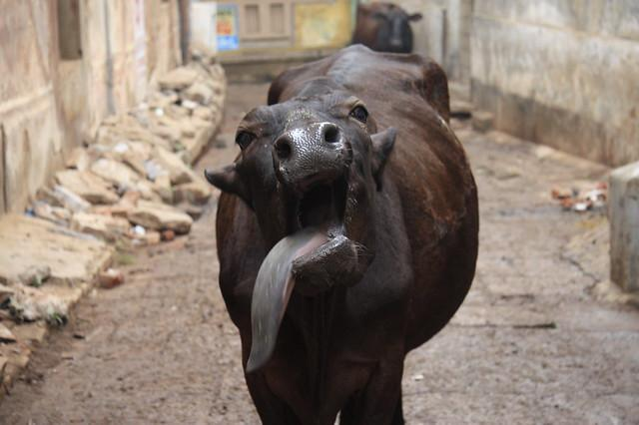
Testing Process
Image Scaling
Is sick
Cattle Image
Compression Algorithm
Classification Model
Output

Slide 5
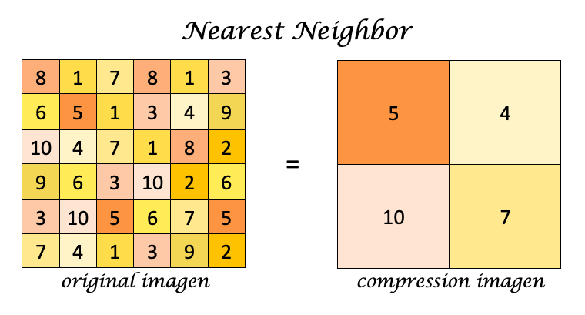
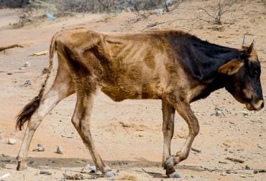
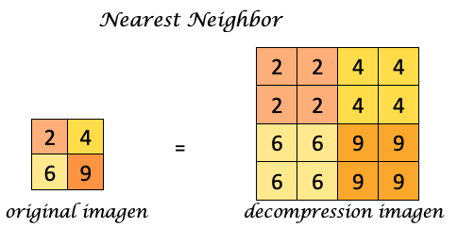
Compression Algorithm Design
Image compression and decompression algorithm for animal-health automatic classification generated from Nearest Neighbor interpolation, we increase or decrease the size of the image by replacing each pixel with the closest one in the output.

Slide 6
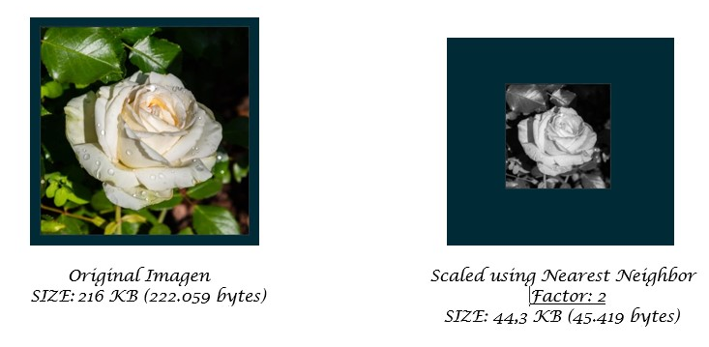
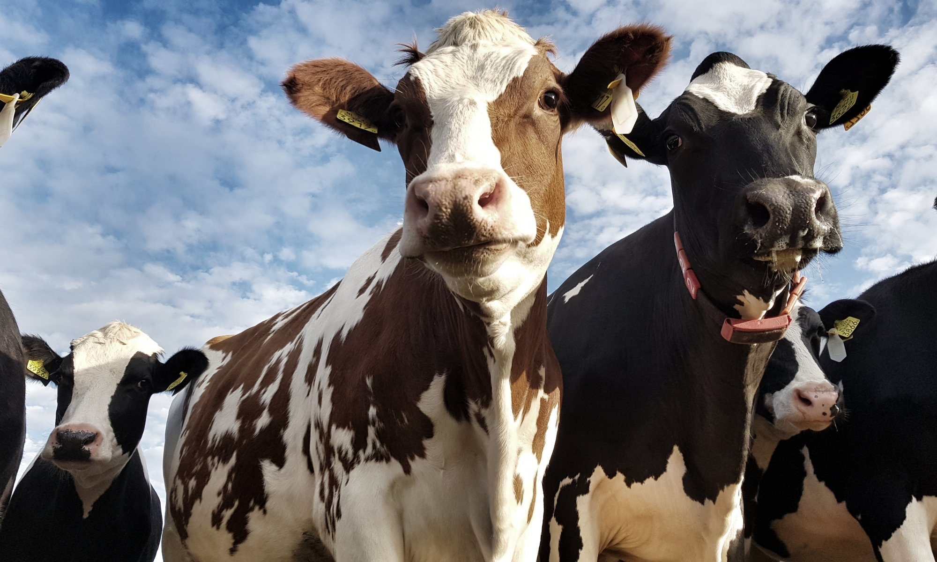
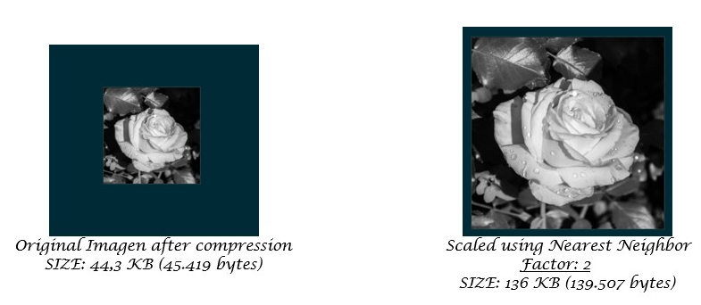
Compression Algorithm Design
Compression and decompression generated using Image Scaling with Nearest Neighbor and BFS.

Slide 7
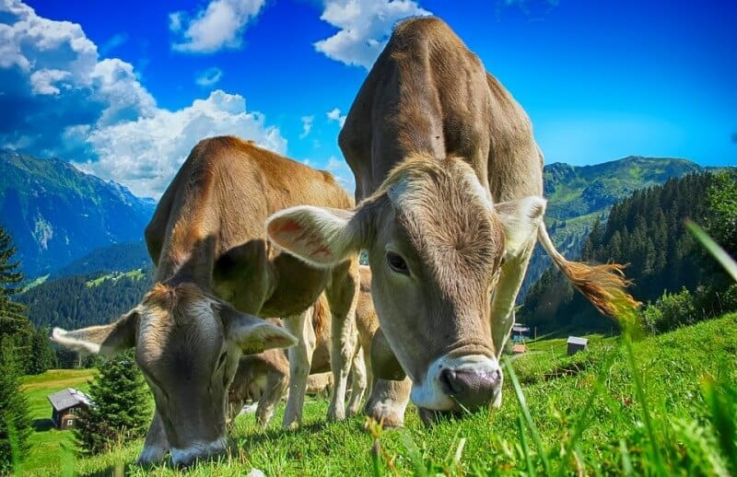
Compression Algorithm Complexity
 | Time Complexity | Memory Complexity
Image Scalling Compression | O(N*M) | O(N*M)
Image Scalling Decompression | O(N*M) | O(N*M)
Run Length Compression | O(N*M) | O(N*M)
Run Length Decompression | O(N*M) | O(N*M)
The complexity for the time and memory when the algorithms traversing an image is O(N*M), ´cause this are compuse of an only matrix that runs through the columns and the rows of the image. Being N and M are the length of the matrix (Columns and Rows).

Slide 8
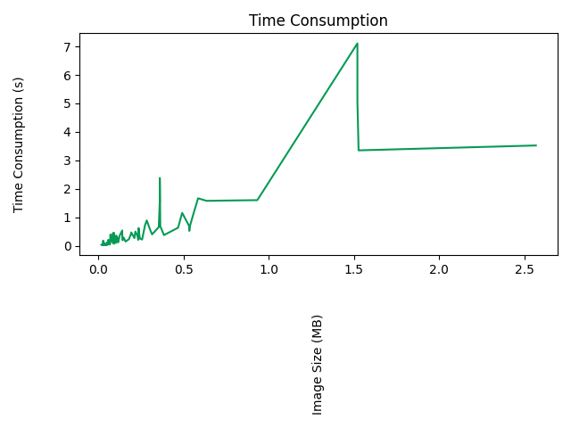
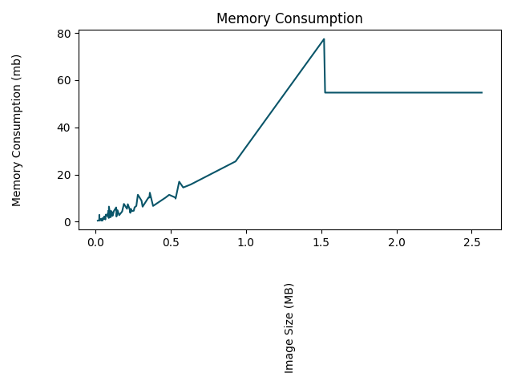


Time and Memory Consumption
Time Consumption
Memory Consumption
Compr_IS

Slide 9
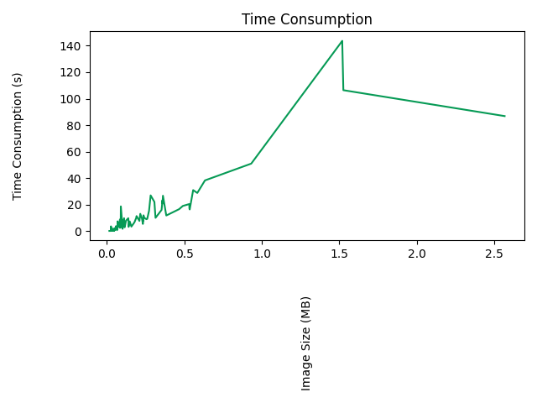
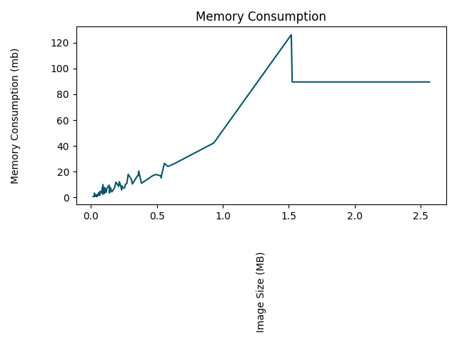
Time and Memory Consumption
Time Consumption
Memory Consumption
Deco_IS

Slide 10
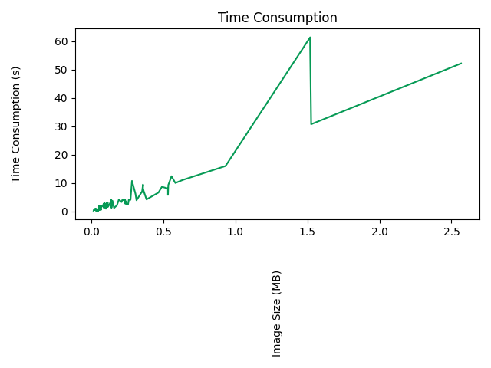
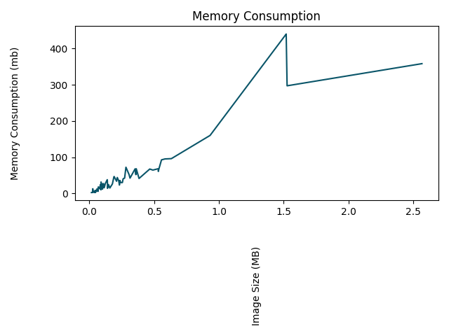
Time and Memory Consumption
Time Consumption
Memory Consumption
Compr_RL

Slide 11
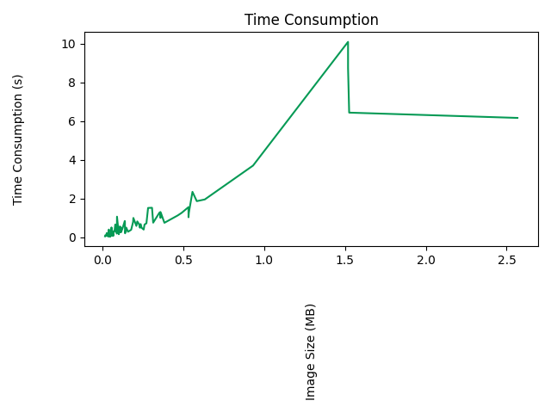
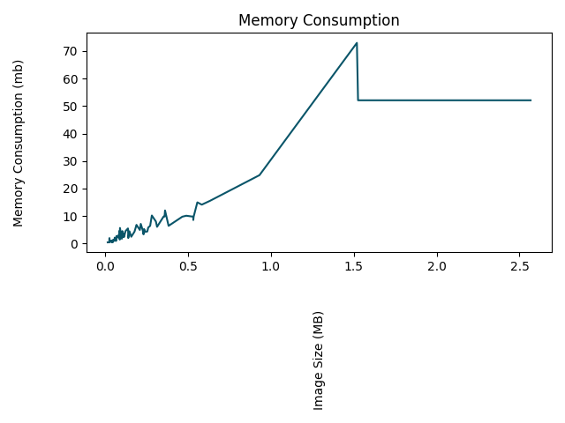
Time and Memory Consumption
Time Consumption
Memory Consumption
Deco_RL

Slide 12
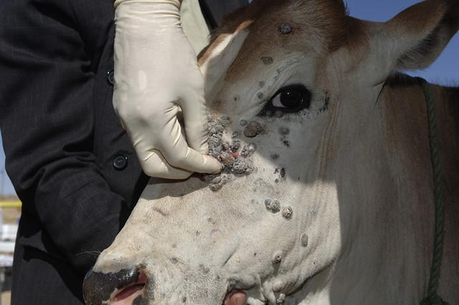
Average Compression Ratio
Create the table in Powerpoint. Do not copy pixelated screenshots from the technical report please!
 | Compression Ratio
Healthy Cattle | 11 : 0,1
Sick Cattle | 11 : 0,1
Average compression ratio for Healthy Cattle and Sick Cattle.
Explain the tables in your
own words

Slide 13
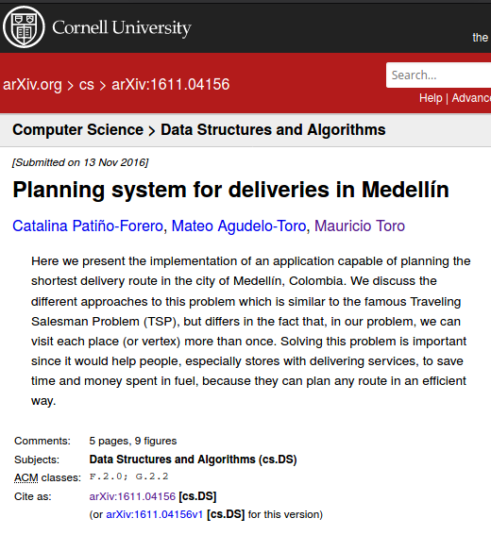
Complete this slide
For the third deliverable
Report Accepted on arXiv
Keep this title
DO NOT use red color in the slides
Include the citation of the report in arXiv and link. Alternatively, use OSF
C. Patiño-Forero, M. Agudelo-Toro, and M. Toro. Planning system for deliveries in Medellín. ArXiv e-prints, Nov. 2016. Available at: https://arxiv.org/abs/1611.04156
Include a screenshot
Include the teaching assistant and professor, please

Slide 14
THANK YOU!.

